Slide 1
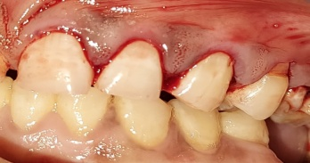
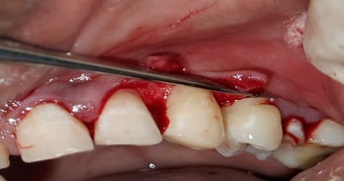
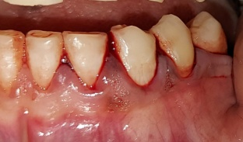
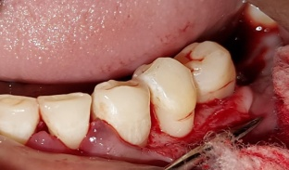
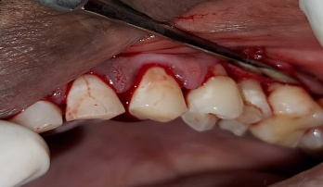
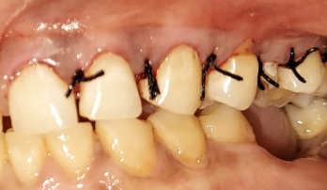
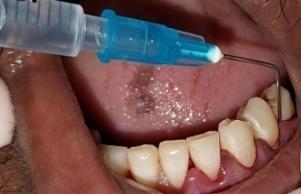
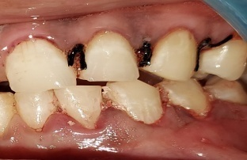
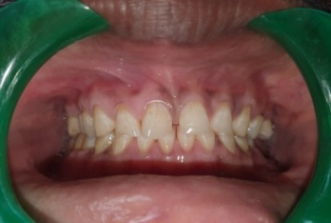
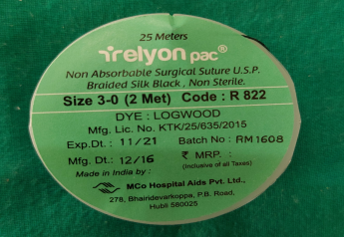
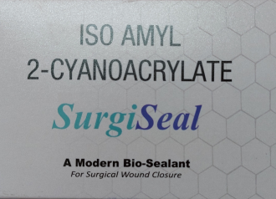
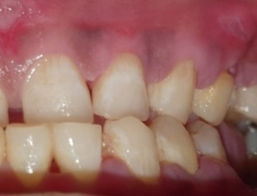
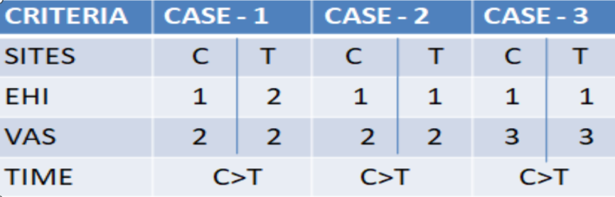
POSTER ID. : CR-PO-056
TITLE: A split mouth clinical study to comparatively evaluate healing after periodontal flap surgery using cyanoacrylate and silk suture material.
INTRODUCTION: Primary closure of flap margins is a very important aspect of the treatment outcome as it is the key to the establishment of a healthy dento-gingival unit. Even though silk sutures have long been used for flap closure they have found to have inflammatory tissue response and act as a reservoir for secondary infection. To overcome these drawbacks, the need for a better alternative is always present. One such alternative is a group of tissue adhesives called cyanoacrylates.
OBJECTIVES: To compare the efficacy of Isoamyl cyanoacrylate with braided silk sutures after a periodontal flap surgery in terms of wound healing, postoperative pain experienced by study subjects after 1 week post-operatively and time required for the flap closure.
METHODOLOGY: This case series is carried out on three patients who needed flap surgical therapy using a split mouth design comparing braided silk sutures with isoamyl cyanoacrylate. The parameters measured were Early Healing Index (EHI), Visual Analogue Scale (VAS) and time taken.
CONTROL SITE (C)
TEST SITE (T)
RESULTS
CONCLUSION
Both silk suture material and cyanoacrylate have been used in primary closure of flap. Silk suture material had better early wound healing and less post operative pain than cyanoacrylate whereas the time taken was less for cyanoacrylate..

